Slide 1


Sentiment Analysis of Yelp Restaurant Reviews
Comparing LSTM and DistilBERT Models
Team Members:
Jenil Pancholi[N01665133]
Hozefa Patel [N01686385]
Dev Ariwala [N01664568]

Slide 2

Introduction
Objective
Importance
To perform sentiment analysis on Yelp restaurant reviews using LSTM and DistilBERT models.
Understanding customer sentiment helps businesses improve their services and tailor marketing strategies.

Slide 3
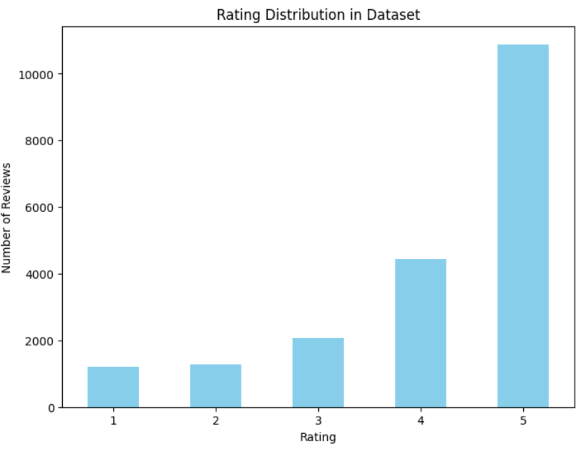

Dataset Overview
Yelp Reviews: Collection of restaurant reviews with ratings from 1 to 5 stars
Sentiment Mapping:
4-5 Stars: Positive
3 Stars: Neutral
1-2 Stars: Negative

Slide 4
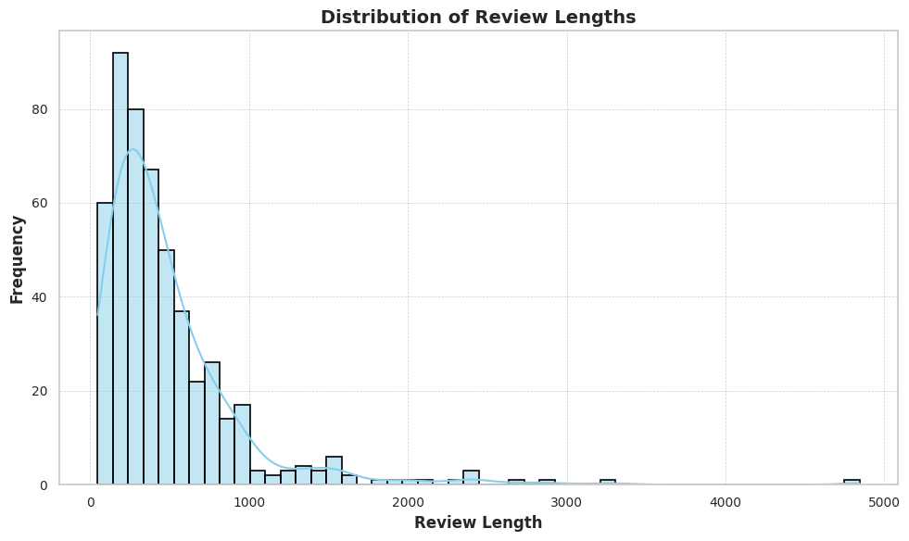
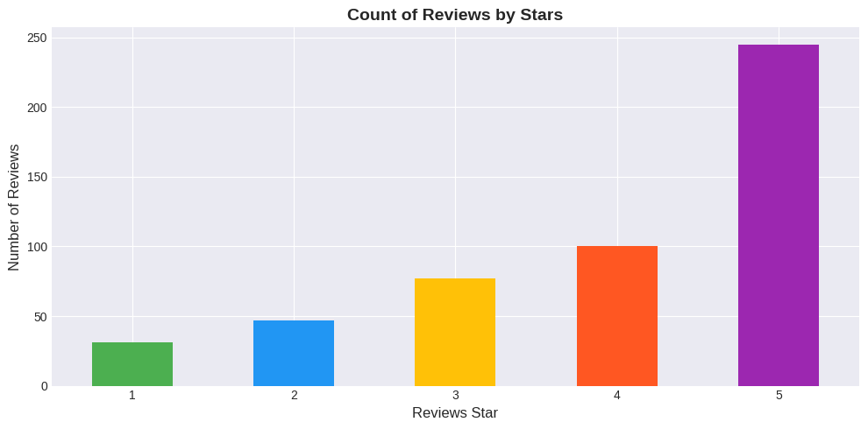
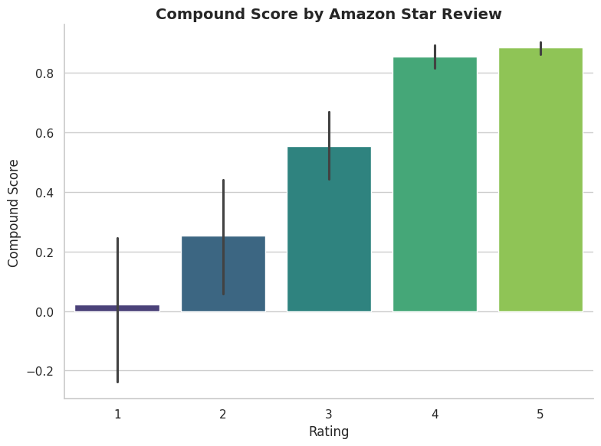
Visualizations

Slide 5
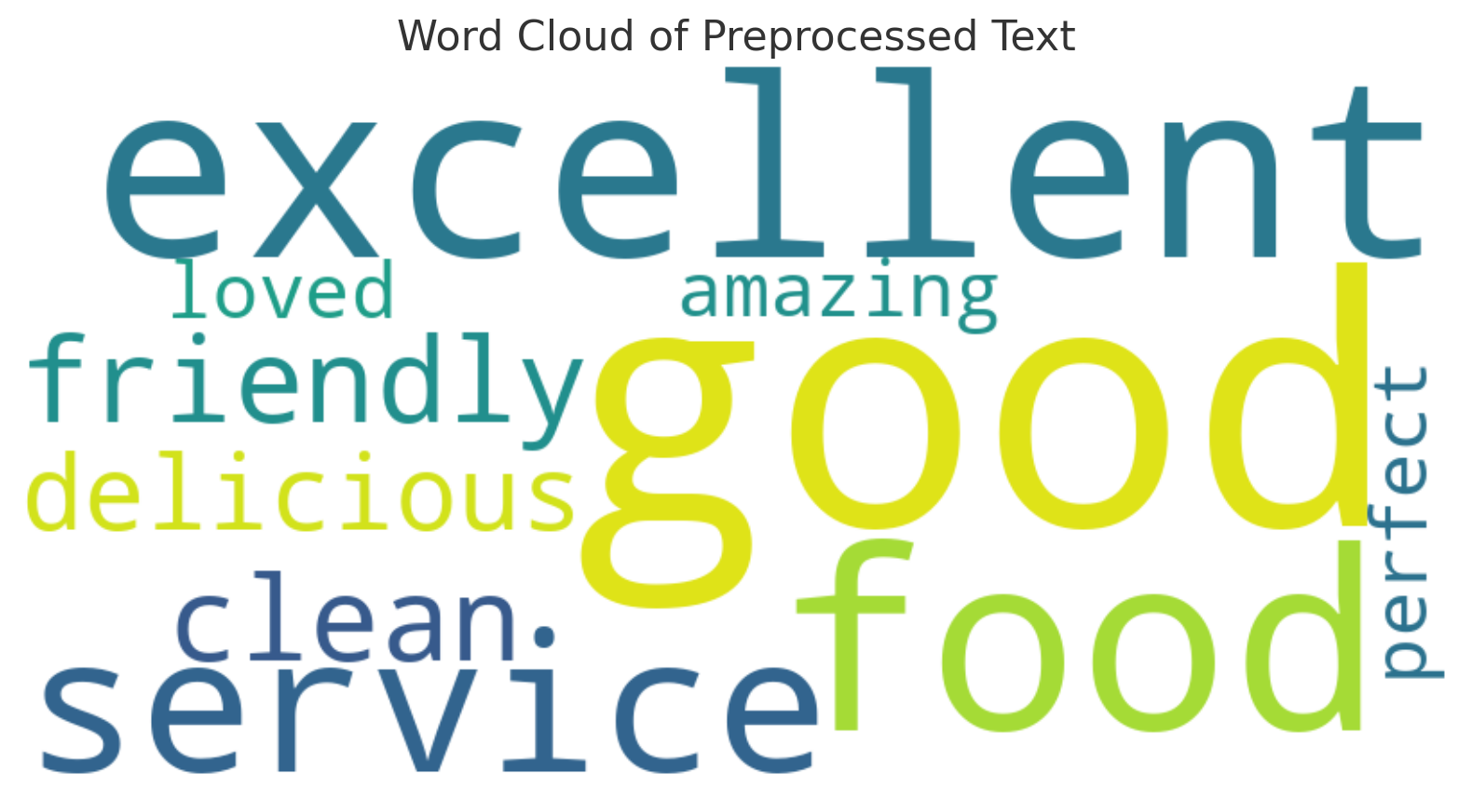

Data Preprocessing
Text Cleaning: HTML tags, punctuation removed, text converted to lowercase.
Train-Test Split for LSTM:
train_test_split is used with test_size=0.2, resulting in an 80% training and 20% testing split.
Train-Test Split for DistilBERT:
The same 80% training and 20% testing split is applied.

Slide 6
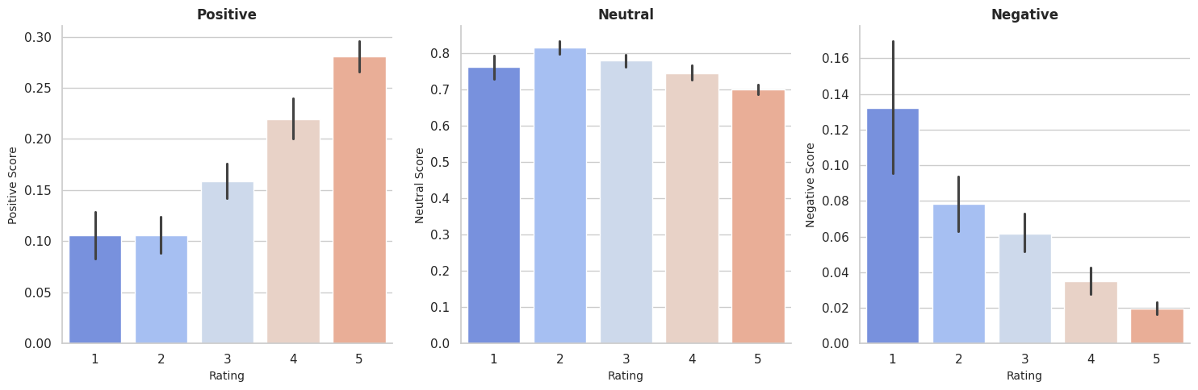
Sentiment Intensity Analyzer

Slide 7
Model Architectures - 1
LSTM:
Embedding Layer: 100-dimensional embeddings
First LSTM Layer: 128 units with return_sequences=True
Second LSTM Layer: 64 units
Dense Layer: 64 units with ReLU activation
Dropout Layer: 50% dropout rate
Output Layer: 1 unit with sigmoid activation (binary classification)

Slide 8
Model Architectures - 2
DistilBERT
Tokenizer: DistilBertTokenizer from distilbert-base-uncased
Encoding Parameters:
Maximum sequence length: 200
Model Architecture:
Uses a custom layer DistilBERTClassifier that integrates TFDistilBertModel.
Training:
Batch Size: 32
Data converted to TensorFlow datasets for training and testing

Slide 9
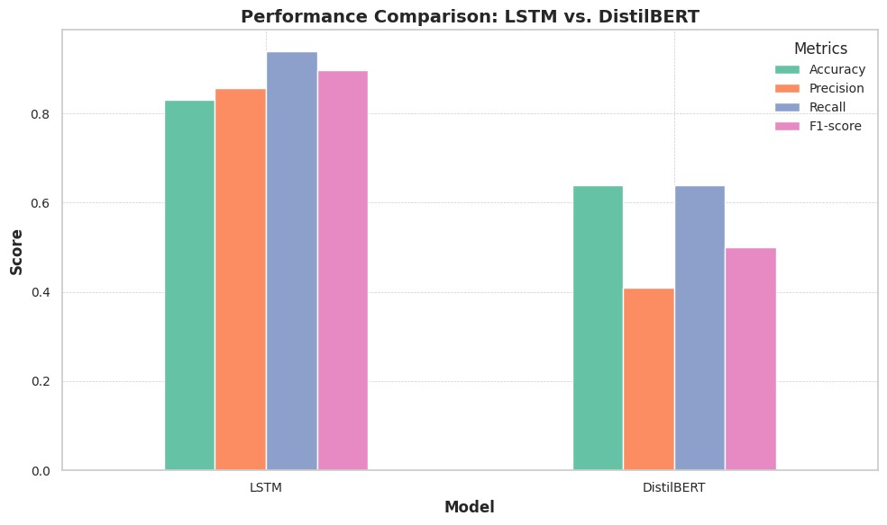
Model Performance
LSTM:
Accuracy: 83%
F1 Score: 89.64%
DistilBERT:
Accuracy: 64%
F1 Score: 49%

Slide 10
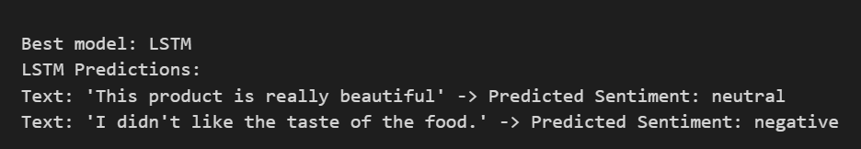
Test Result

Slide 11


Thanks!

